Slide 1
Computer Vision
Part 4: One-Stage Object Detection
ADF – Start 08:30

Slide 2

Agenda
Part 1: Object Localization
Part 2: Classical Object Detection
Part 3: Two-Stage Object Detection
Part 4: One-Stage Object Detection
Computer Vision

Slide 3
Recap
Computer Vision

Slide 4
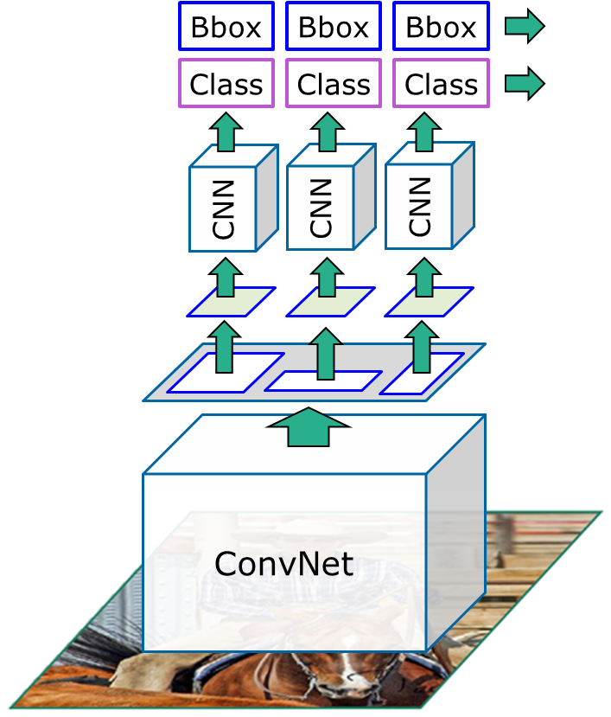
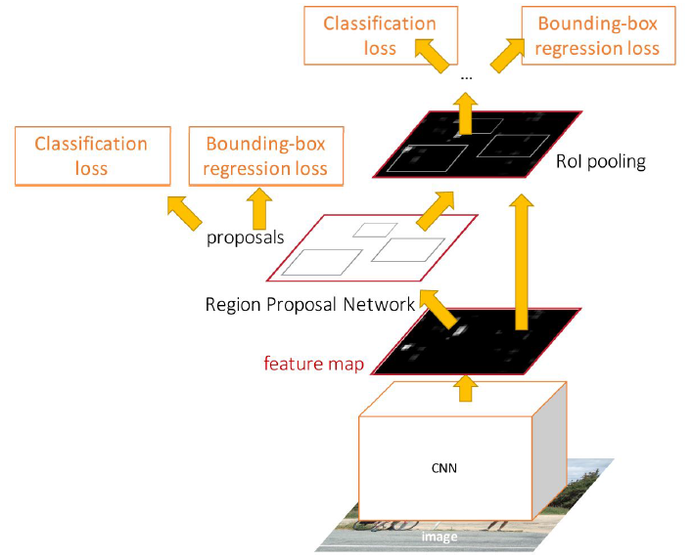
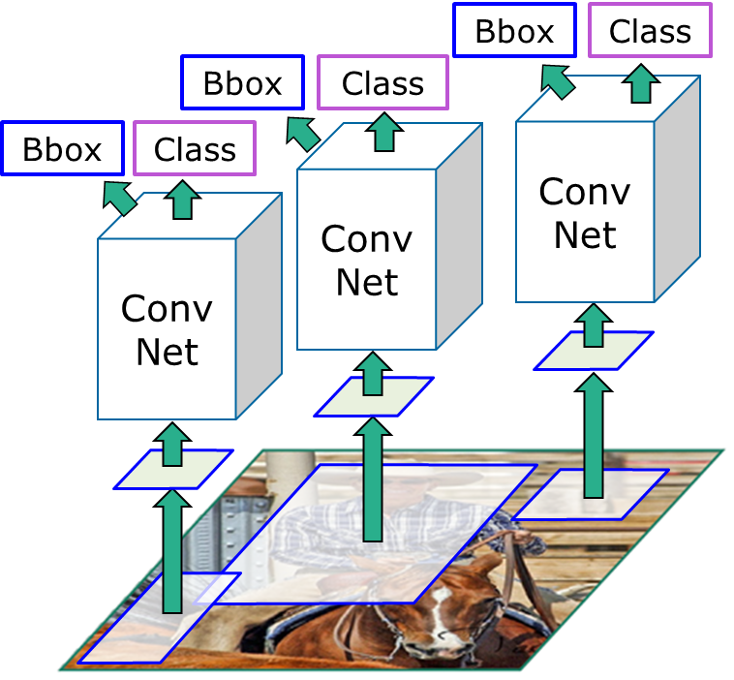
Last Week
“Slow” R-CNN
Fast R-CNN
Faster R-CNN
Computer Vision

Slide 5
R-CNN
“Slow” R-CNN
Region Proposal on Image
Crop and Resize on Image
Extract Feature using ConvNet
Classify and Regress Bounding Box
Post-hoc training pipeline
Run CNN independently for each region
[Girschick et al, “Rich feature hierarchies for accurate object detection and semantic segmentation”, CVPR 2014]
Computer Vision

Slide 6
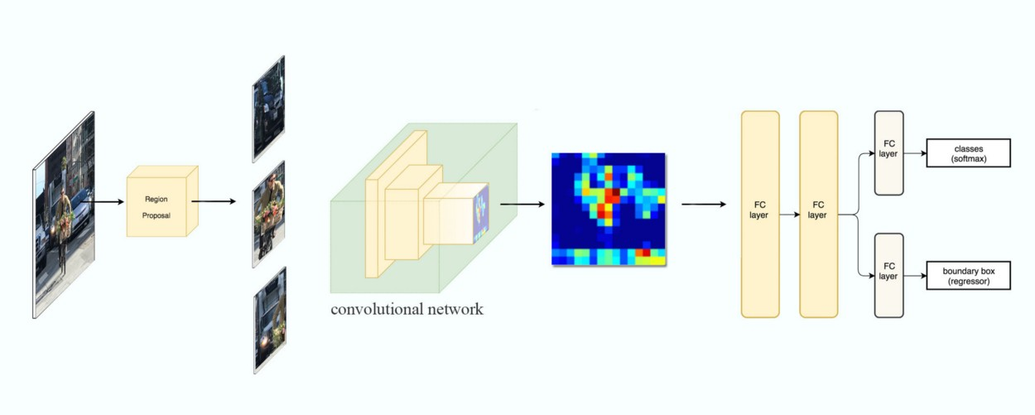
R-CNN
[Girschick et al, “Rich feature hierarchies for accurate object detection and semantic segmentation”, CVPR 2014]
Computer Vision

Slide 7
Fast R-CNN
Swap convolution and warping
Extract Feature using ConvNet
Region Proposal on Image
Crop and Resize on Features
Classify and Regress using Per-Region Network
Training end-to-end
Bottleneck at Region Proposal
[Girshick, “Fast R-CNN”, ICCV 2015.]
Computer Vision

Slide 8
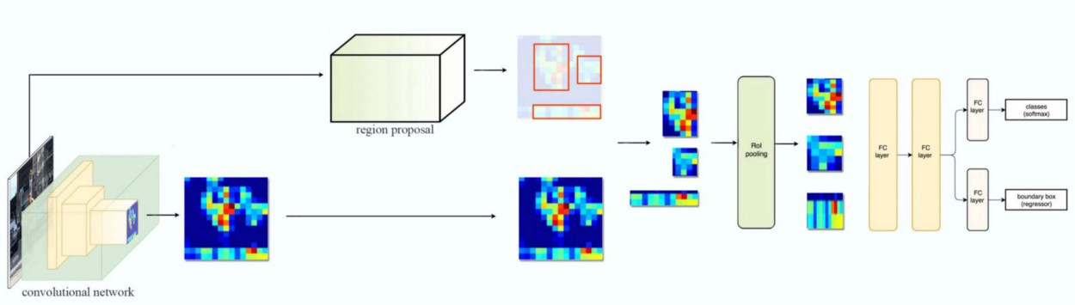
Fast R-CNN
[Girshick, “Fast R-CNN”, ICCV 2015.]
Computer Vision

Slide 9
Faster R-CNN
Region Proposal Network
Extract Feature using ConvNet
Region Proposal on feature using ConvNet
Crop and Resize on feature
Classify and Regress using Per-Region Network
Training end-to-end with 4 losses
Fast enough to run in real time
[Ren et al, “Faster R-CNN: Towards Real-Time Object Detection with Region Proposal Networks”, NIPS 2015]
Computer Vision

Slide 10

Faster R-CNN
[Ren et al, “Faster R-CNN: Towards Real-Time Object Detection with Region Proposal Networks”, NIPS 2015]
Computer Vision

Slide 11
Last Week
 | R-CNN | Fast R-CNN | Faster R-CNN
Test time per image with proposal | 49 seconds | 2.3 seconds | 0.2 seconds
speedup | 1x | 25x | 250x
mAP (VOC 2007) | 66.0 | 66.9 | 66.9
Computer Vision

Slide 12
Faster R-CNN: Two-staged
First: Run per image
Backbone network
Region proposal network
Second: Run per region
Crop features: RoI pool / align
Predict object class
Prediction bbox offset
Computer Vision

Slide 13
Faster R-CNN: Two-staged
It’s fast, but the process is still about 7 FPS
Can we make it even faster?
Do we really need the second stage?
Computer Vision

Slide 14

YOLO/SSD Detection
Computer Vision

Slide 15
Single-Stage Object Detection
RPN: Classify each anchor as object / not object
Single-Stage Detector: Classify each object as one of C categories (or background)
Computer Vision

Slide 16
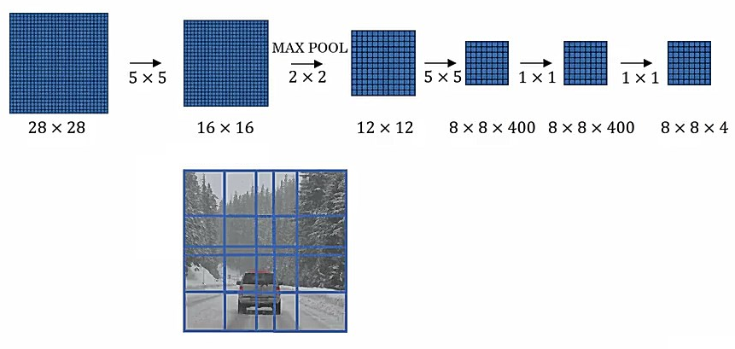
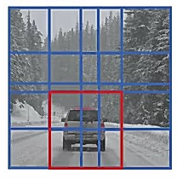
Recall OverFeat
14
14
[Sermanet et al, “Integrated Recognition, Localization and Detection using Convolutional Networks”, ICLR 2014]
Computer Vision

Slide 17
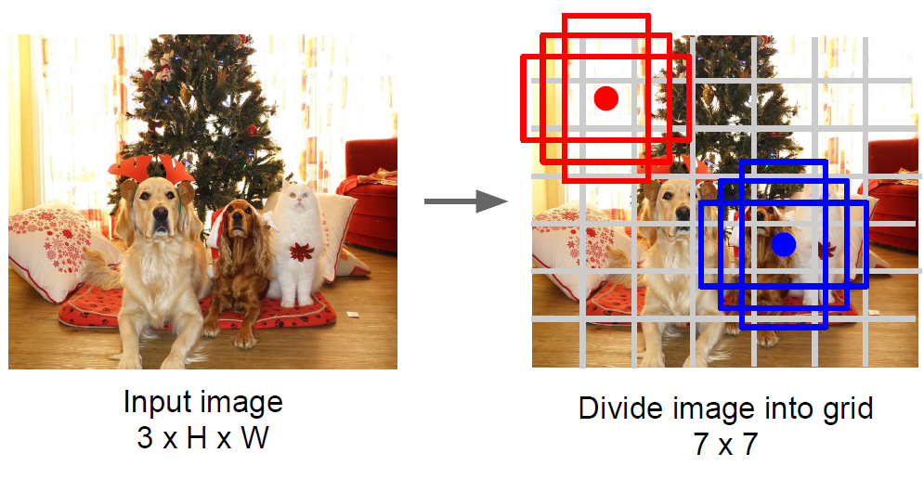
Multiple Anchor Boxes
Computer Vision

Slide 18
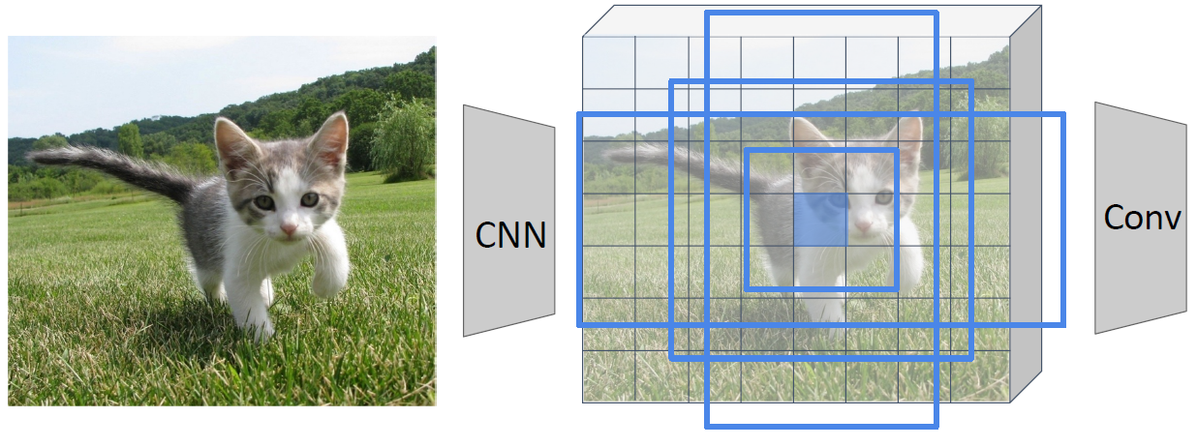
Single-Stage Object Detection
Run backbone CNN to get features aligned to input image
Remember: K anchors at each position in image feature map
Anchor category
(C+1) x K x W x H
Box Transforms
4K x W x H
K: number of anchor
[Redmon et al, “You Only Look Once: Unified, Real-Time Object Detection”, CVPR 2016]
Liu et al, “SSD: Single-Shot MultiBox Detector”, ECCV 2016
Computer Vision

Slide 19
Single-Stage Object Detection
Usually it’s better with category-specific regression:
Predict different box transforms for each category
Anchor category
(C+1) x K x W x H
Box Transforms
C x 4K x W x H
K: number of anchor
[Redmon et al, “You Only Look Once: Unified, Real-Time Object Detection”, CVPR 2016]
Liu et al, “SSD: Single-Shot MultiBox Detector”, ECCV 2016
Computer Vision

Slide 20
Single-Shot Detection
Computer Vision

Slide 21
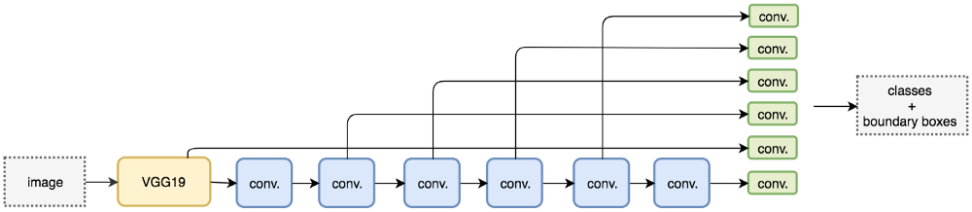
Single Shot Detector
Use VGG16 + Custom Convolution Layers
Use multi-scale object detection from multiple feature maps
Liu et al, “SSD: Single-Shot MultiBox Detector”, ECCV 2016
Computer Vision

Slide 22
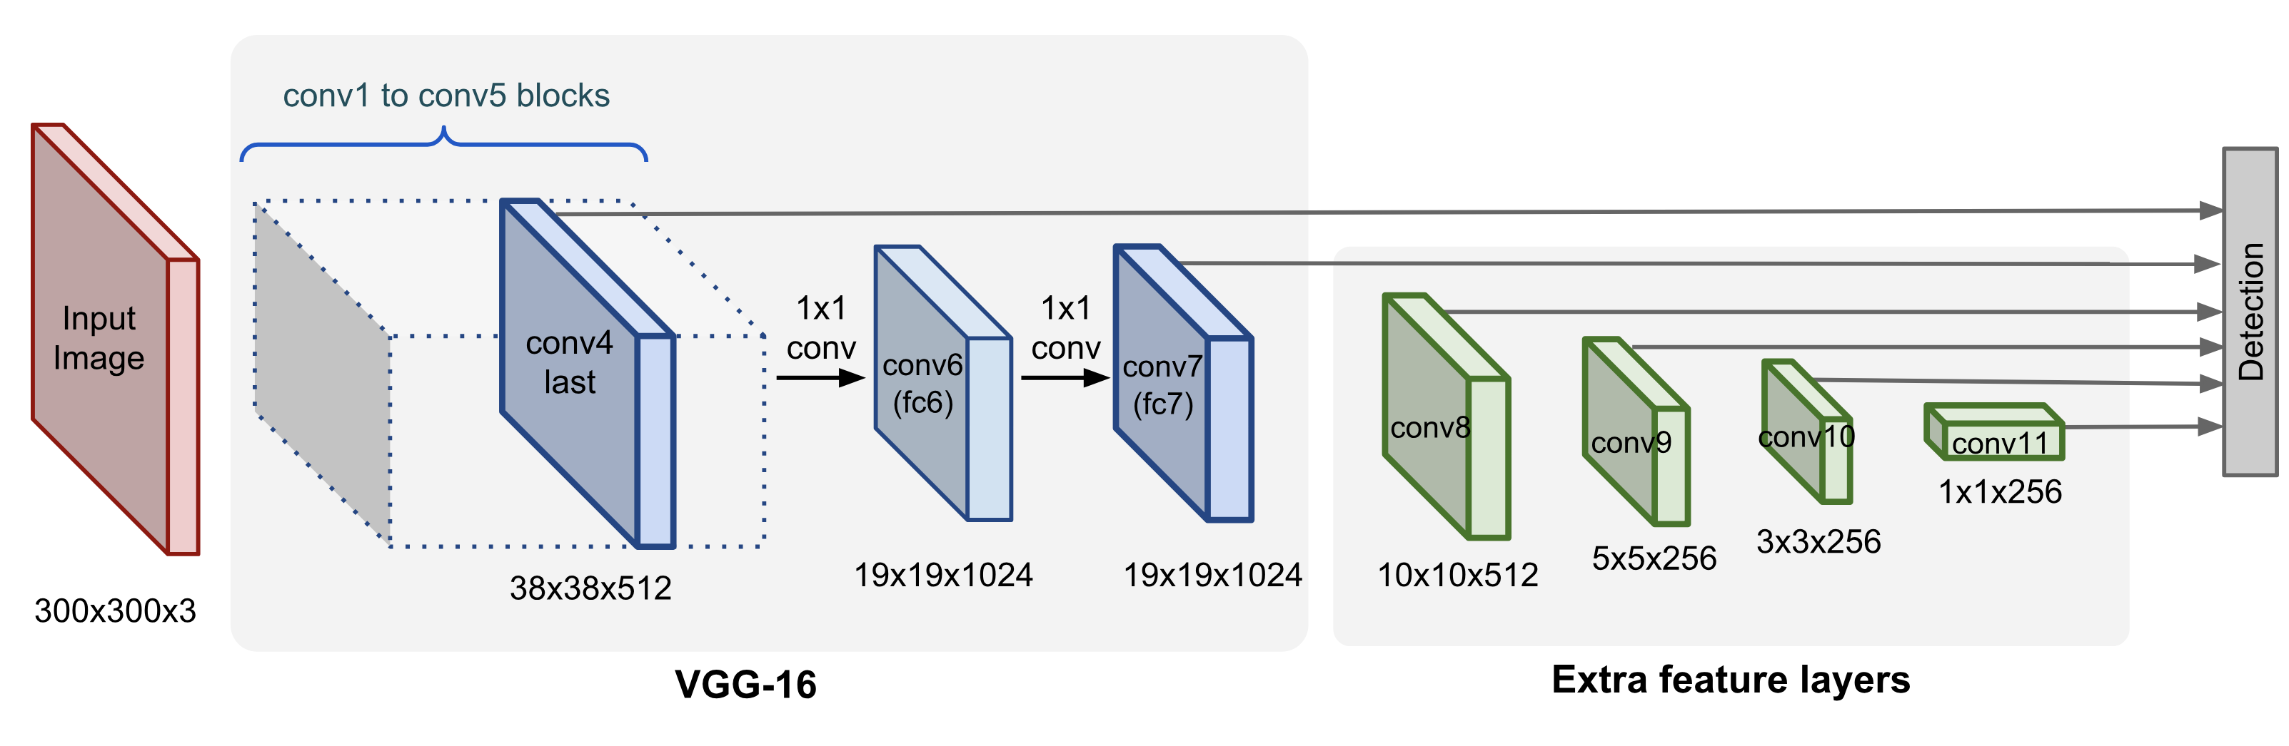
Single Shot Detector
SSD only uses upper layers for detection and therefore performs much worse for small objects.
Liu et al, “SSD: Single-Shot MultiBox Detector”, ECCV 2016
Computer Vision

Slide 23
You Only Look Once Detection
Computer Vision

Slide 24
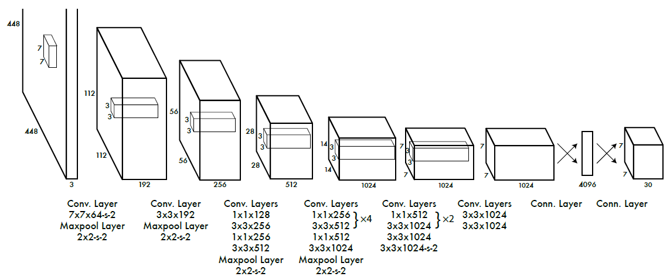
YOLO Detector
[Redmon et al, “You Only Look Once: Unified, Real-Time Object Detection”, CVPR 2016]
Computer Vision

Slide 25
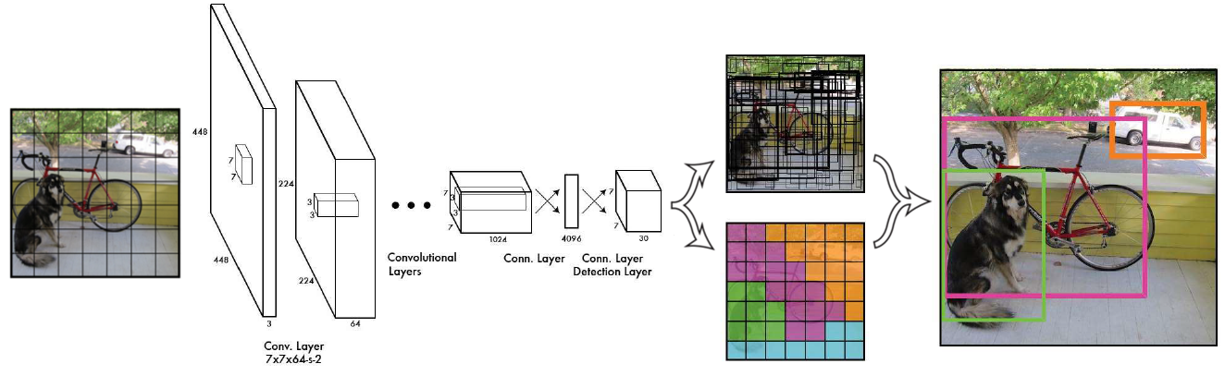
YOLO Detector
[Redmon et al, “You Only Look Once: Unified, Real-Time Object Detection”, CVPR 2016]
Computer Vision

Slide 26
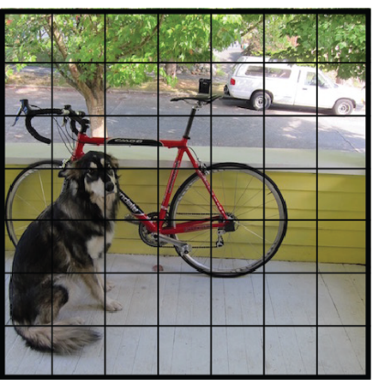
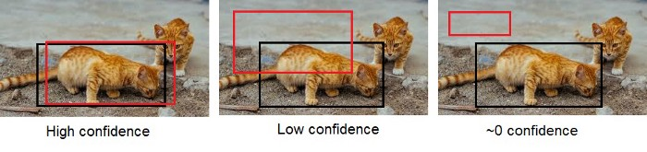
YOLO Detector
Divide image into S x S grid (WxH)
Within each grid cell predict:
B Bounding Boxes: each 4 coordinates + confidence
Class scores: C numbers
Regression from image to S x S x (5 * B + C) tensor
Direct prediction using a CNN
[Redmon et al, “You Only Look Once: Unified, Real-Time Object Detection”, CVPR 2016]
Computer Vision

Slide 27
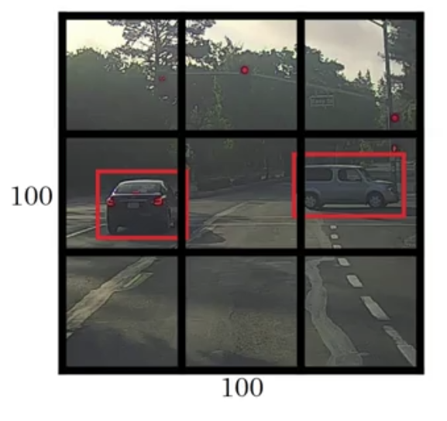
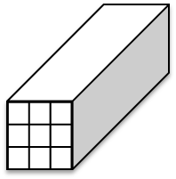
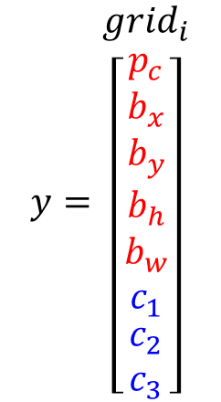
YOLO Detector
Class= [ car, pedestrian, none ]
S = 3, B = 1, C = 3
$$y=\begin{matrix}{grid}_{i} \\ \left[\begin{matrix}\begin{matrix}p_{c} \\ b_{x} \\ b_{y}\end{matrix} \\ b_{h} \\ \begin{matrix}b_{w} \\ c_{1} \\ \begin{matrix}c_{2} \\ c_{3}\end{matrix}\end{matrix}\end{matrix}\right]\end{matrix}$$
Target output =
3x3x(5*1+3)
[Redmon et al, “You Only Look Once: Unified, Real-Time Object Detection”, CVPR 2016]
Liu et al, “SSD: Single-Shot MultiBox Detector”, ECCV 2016
Computer Vision

Slide 28
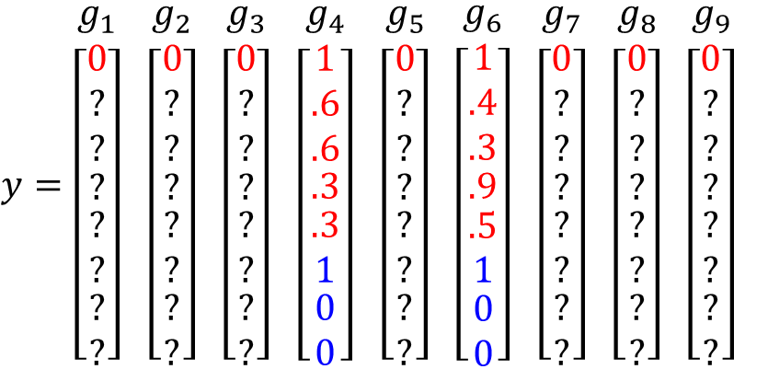
YOLO Detector
Class= [ car, pedestrian, none ]
S = 3, B = 1, C = 3
$y=\begin{matrix}g_{1} \\ \left[\begin{matrix}\begin{matrix}0 \\ ? \\ ?\end{matrix} \\ ? \\ \begin{matrix}? \\ ? \\ \begin{matrix}? \\ ?\end{matrix}\end{matrix}\end{matrix}\right]\end{matrix}$ $\begin{matrix}g_{2} \\ \left[\begin{matrix}\begin{matrix}0 \\ ? \\ ?\end{matrix} \\ ? \\ \begin{matrix}? \\ ? \\ \begin{matrix}? \\ ?\end{matrix}\end{matrix}\end{matrix}\right]\end{matrix}$ $\begin{matrix}g_{3} \\ \left[\begin{matrix}\begin{matrix}0 \\ ? \\ ?\end{matrix} \\ ? \\ \begin{matrix}? \\ ? \\ \begin{matrix}? \\ ?\end{matrix}\end{matrix}\end{matrix}\right]\end{matrix}$ $\begin{matrix}g_{4} \\ \left[\begin{matrix}\begin{matrix}1 \\ .6 \\ .6\end{matrix} \\ .3 \\ \begin{matrix}.3 \\ 1 \\ \begin{matrix}0 \\ 0\end{matrix}\end{matrix}\end{matrix}\right]\end{matrix}$ $\begin{matrix}g_{5} \\ \left[\begin{matrix}\begin{matrix}0 \\ ? \\ ?\end{matrix} \\ ? \\ \begin{matrix}? \\ ? \\ \begin{matrix}? \\ ?\end{matrix}\end{matrix}\end{matrix}\right]\end{matrix}$ $\begin{matrix}g_{6} \\ \left[\begin{matrix}\begin{matrix}1 \\ .4 \\ .3\end{matrix} \\ .9 \\ \begin{matrix}.5 \\ 1 \\ \begin{matrix}0 \\ 0\end{matrix}\end{matrix}\end{matrix}\right]\end{matrix}$ $\begin{matrix}g_{7} \\ \left[\begin{matrix}\begin{matrix}0 \\ ? \\ ?\end{matrix} \\ ? \\ \begin{matrix}? \\ ? \\ \begin{matrix}? \\ ?\end{matrix}\end{matrix}\end{matrix}\right]\end{matrix}$ $\begin{matrix}g_{8} \\ \left[\begin{matrix}\begin{matrix}0 \\ ? \\ ?\end{matrix} \\ ? \\ \begin{matrix}? \\ ? \\ \begin{matrix}? \\ ?\end{matrix}\end{matrix}\end{matrix}\right]\end{matrix}$ $\begin{matrix}g_{9} \\ \left[\begin{matrix}\begin{matrix}0 \\ ? \\ ?\end{matrix} \\ ? \\ \begin{matrix}? \\ ? \\ \begin{matrix}? \\ ?\end{matrix}\end{matrix}\end{matrix}\right]\end{matrix}$
[Redmon et al, “You Only Look Once: Unified, Real-Time Object Detection”, CVPR 2016]
Liu et al, “SSD: Single-Shot MultiBox Detector”, ECCV 2016
Computer Vision

Slide 29
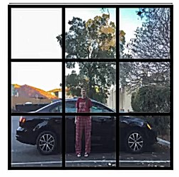
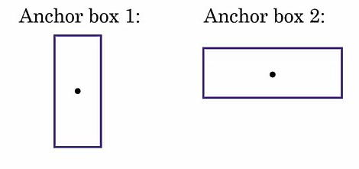
Multiple Anchor Boxes
Label: Car, Pedestrian
[Redmon et al, “You Only Look Once: Unified, Real-Time Object Detection”, CVPR 2016]
Liu et al, “SSD: Single-Shot MultiBox Detector”, ECCV 2016
Computer Vision

Slide 30
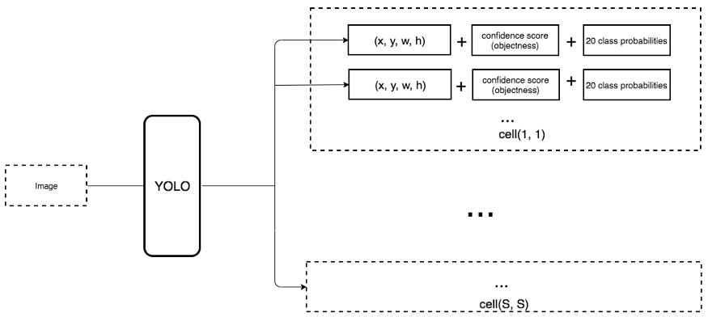
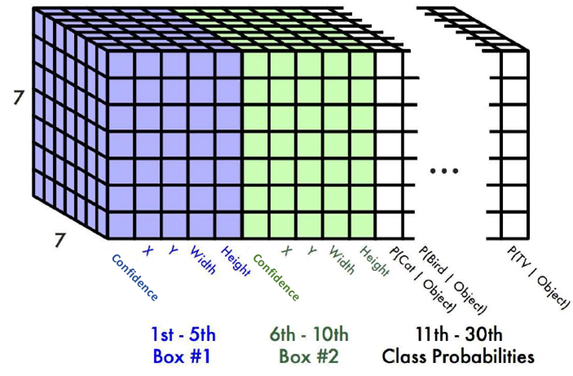
YOLO Detector
7×7×(2×5+20)=1470
[Redmon et al, “You Only Look Once: Unified, Real-Time Object Detection”, CVPR 2016]
Computer Vision

Slide 31
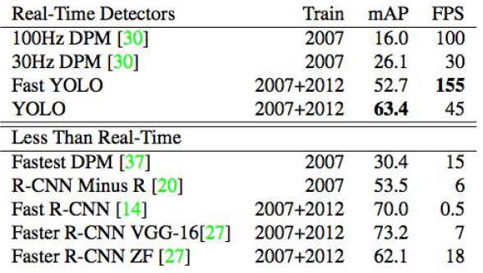
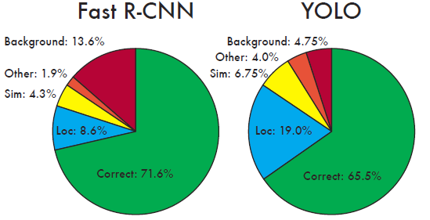
YOLO Detector
Faster than Faster R-CNN But not as good
[Redmon et al, “You Only Look Once: Unified, Real-Time Object Detection”, CVPR 2016]
Computer Vision

Slide 32
YOLO Improvements
YOLOv2 / YOLO9000
Batch normalization
High-resolution classifier
Convolutional with Anchor Boxes
K-mean clustering of box dimensions
Direct location prediction
Multi-scale training
Light-weighted base model
YOLOv3
More complex backbone for feature extraction
Darknet + ResNet: Use 3×3 and 1×1 filters with skip connections
Feature Pyramid Networks (FPN) like Feature Pyramid
less BFLOP, same classification accuracy, 2x faster compared to ResNet-152
[Redmon et al, “YOLO9000: Better, Faster, Stronger.”, CVPR 2017]
[Redmon et al, “Yolov3: An incremental improvement.”, arXiv 2018]
Computer Vision

Slide 33
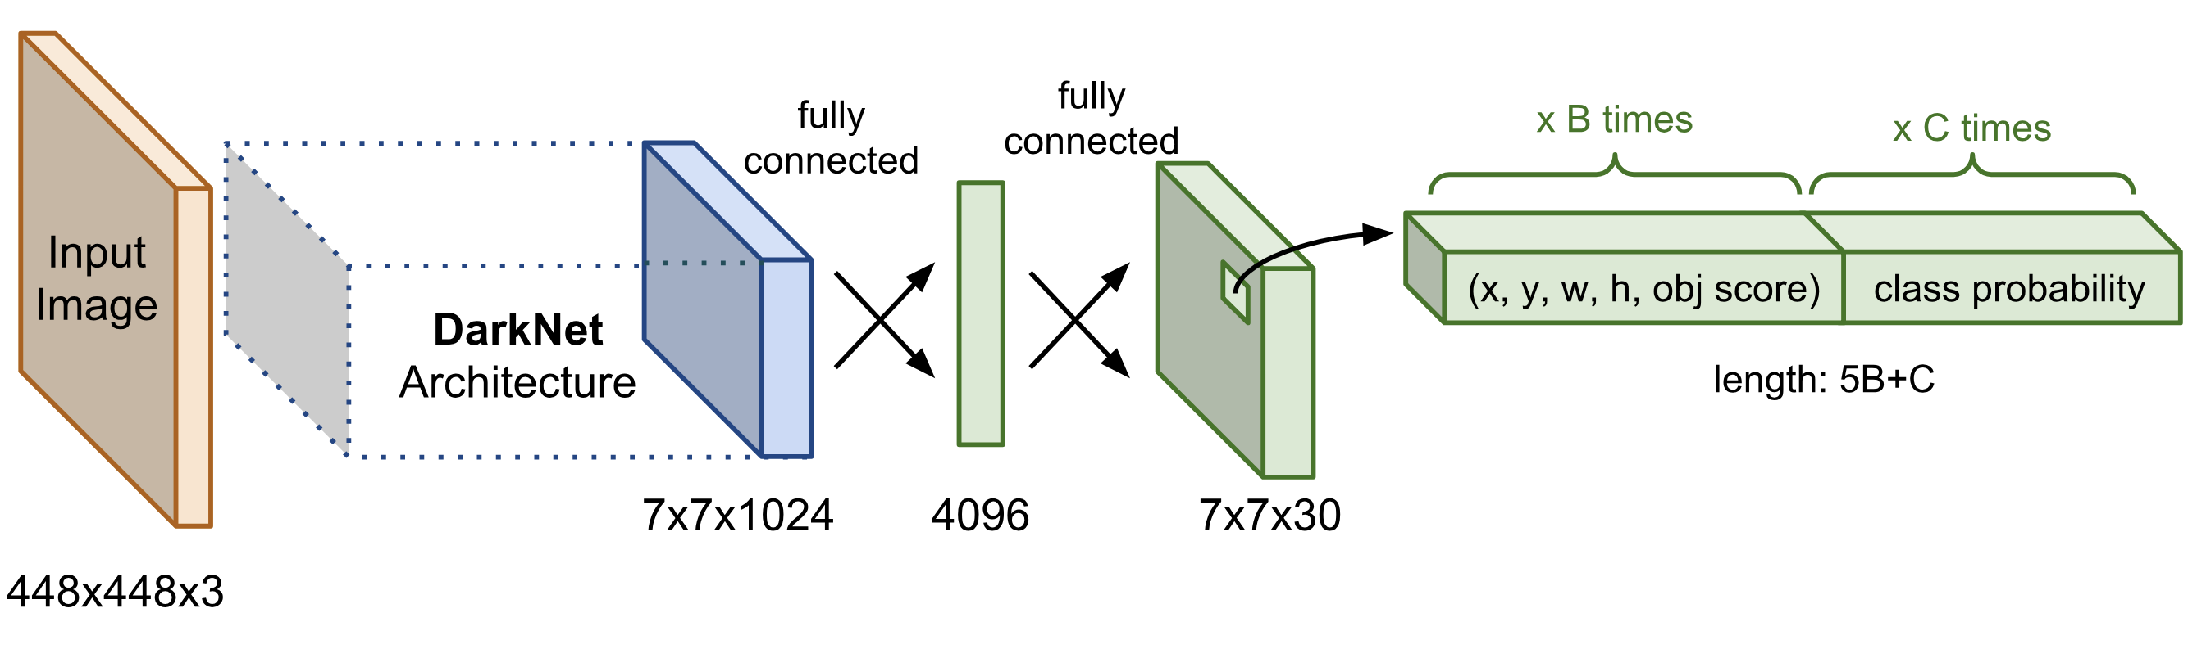
YOLOv1 Detector
Use an architecture called DarkNet
[Redmon et al, “You Only Look Once: Unified, Real-Time Object Detection”, CVPR 2016]
Computer Vision

Slide 34
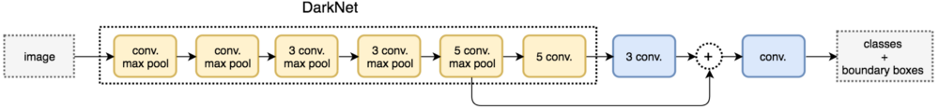
YOLOv2 Detector
Improved: DarkNet-19
Partially flattens features maps and concatenates it with another lower resolution maps
[Redmon et al, “YOLO9000: Better, Faster, Stronger.”, CVPR 2017]
Computer Vision

Slide 35
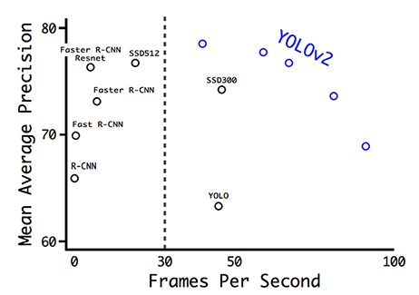
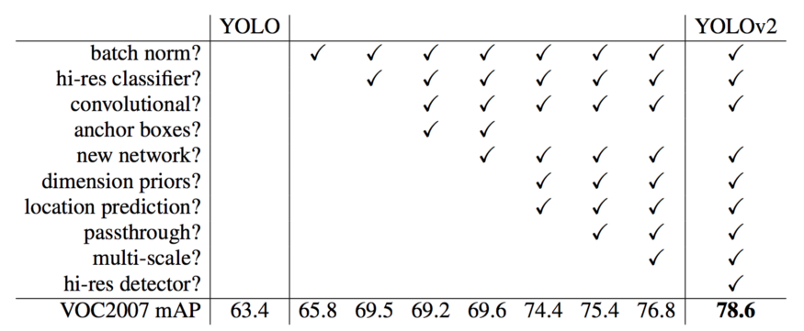
YOLOv2 Detector
[Redmon et al, “YOLO9000: Better, Faster, Stronger.”, CVPR 2017]
Computer Vision

Slide 36
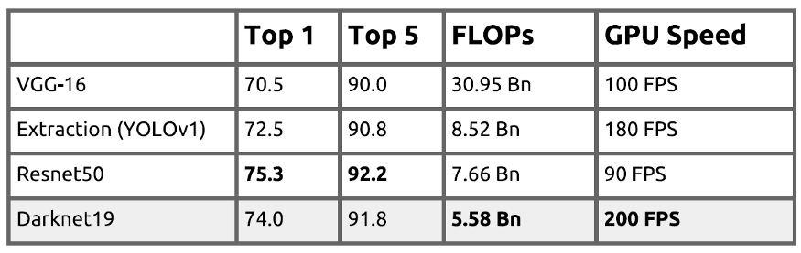
YOLOv2 Detector on PASCAL VOC 2007
76.8% mAP At 67 FPS,
78.6% mAP At 40 FPS
which is equal or better than Faster R-CNN using ResNet and SSD.
[Redmon et al, “YOLO9000: Better, Faster, Stronger.”, CVPR 2017]
Computer Vision

Slide 37
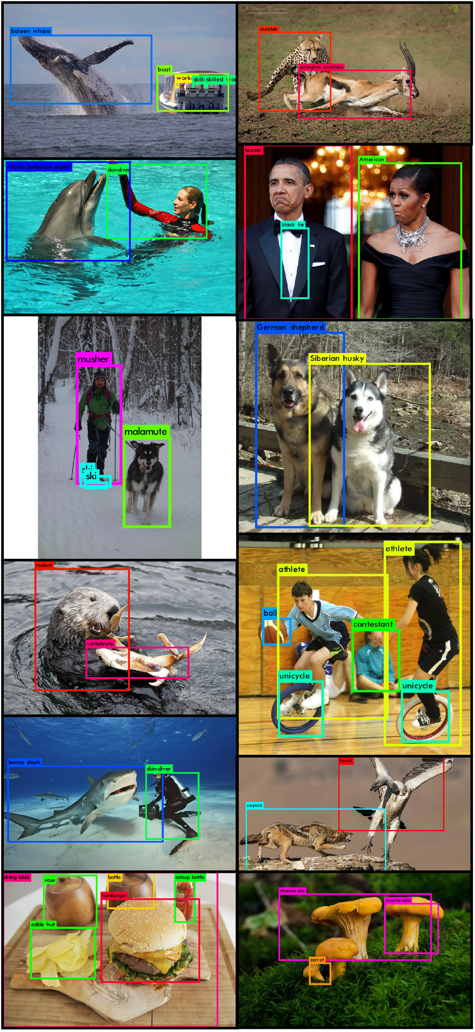
YOLOv2 Detector
[Redmon et al, “YOLO9000: Better, Faster, Stronger.”, CVPR 2017]
Computer Vision

Slide 38
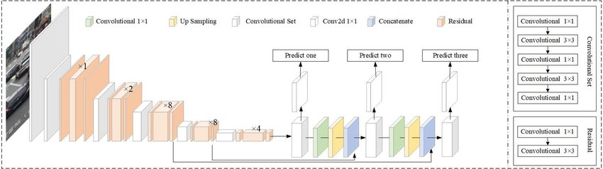
YOLOv3 Detector
Improved: DarkNet-53
predicts boxes at 3 different scales
[Redmon et al, “Yolov3: An incremental improvement.”, arXiv 2018]
Computer Vision

Slide 39
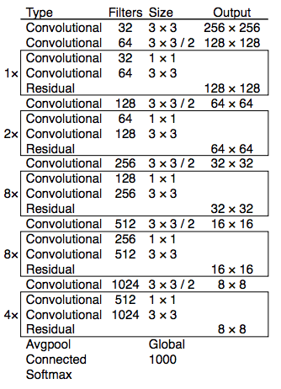
DarkNet-53
DarkNet + ResNet
3×3 and 1×1 filters with skip connections
less BFLOP, same classification accuracy, 2x faster compared to ResNet-152
[Redmon et al, “Yolov3: An incremental improvement.”, arXiv 2018]
Computer Vision

Slide 40
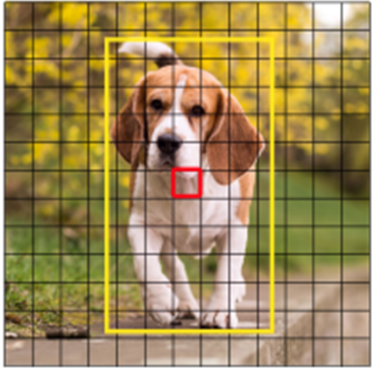
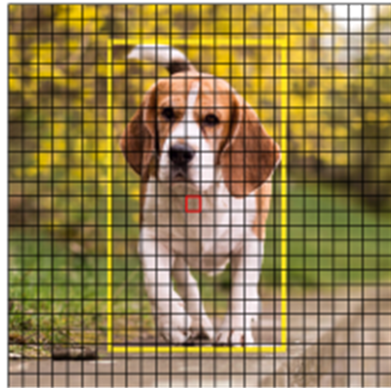
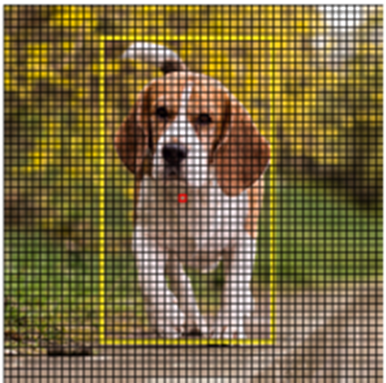
YOLOv3 Detector
Improved: DarkNet-53
predicts boxes at 3 different scales
13x13
26x26
52x52
[Redmon et al, “Yolov3: An incremental improvement.”, arXiv 2018]
Computer Vision

Slide 41
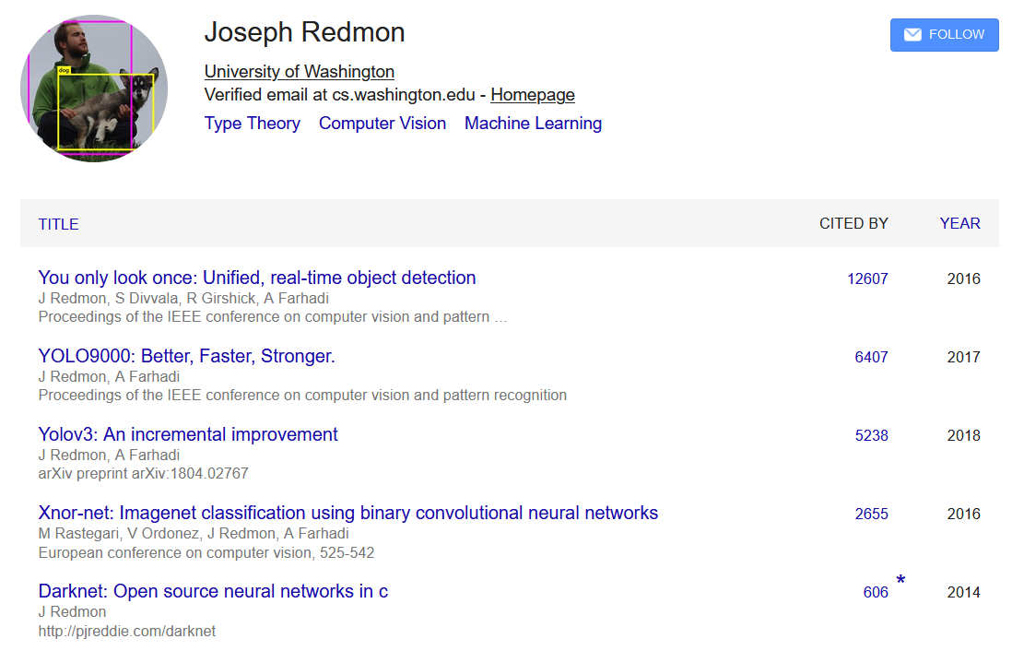
YOLO Citations
Computer Vision

Slide 42
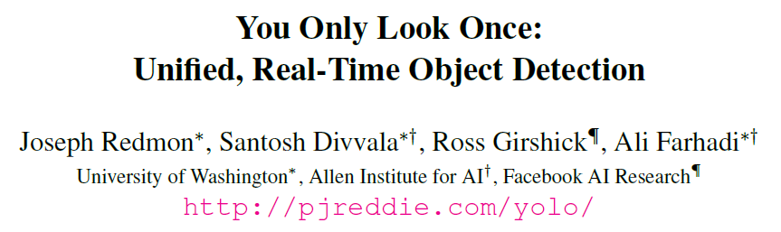

YOLOs’ Uniqueness: Catchy
OpenCV People's Choice Award
Computer Vision

Slide 43
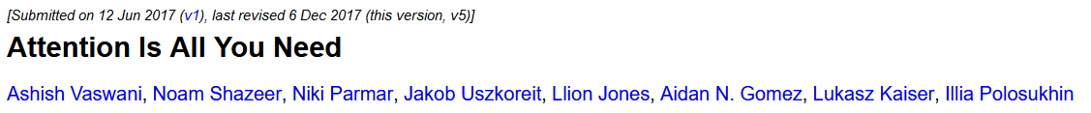
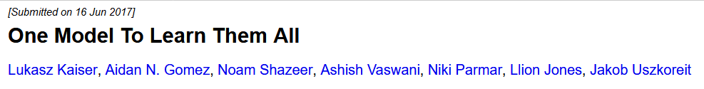
Serious Papers with Funny Titles
Computer Vision

Slide 44
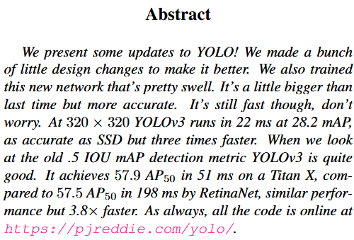
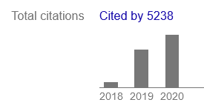
YOLOs’ Uniqueness: Curiosity vs Necessity
published as a 2018 arXiv Technical Report
[Redmon et al, “Yolov3: An incremental improvement.”, arXiv 2018]
Computer Vision

Slide 45
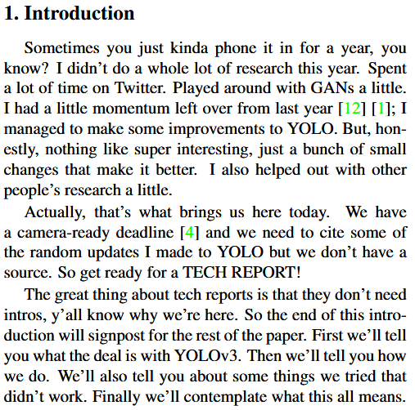
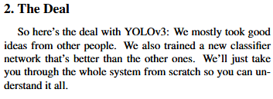
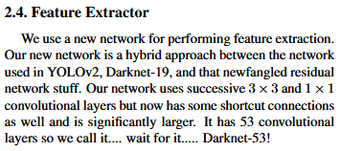
YOLOs’ Uniqueness: Curiosity vs Necessity
[Redmon et al, “Yolov3: An incremental improvement.”, arXiv 2018]
Computer Vision

Slide 46
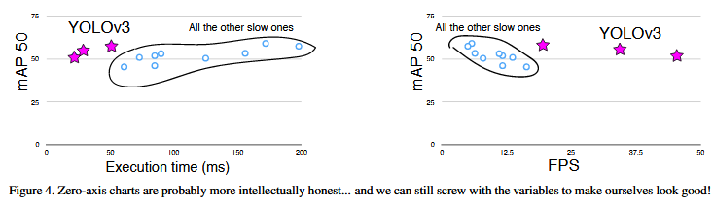
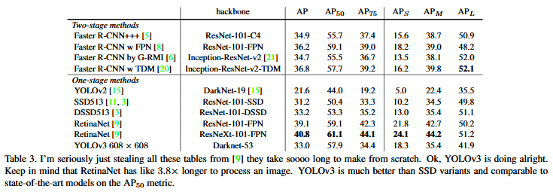
YOLOs’ Uniqueness: Curiosity vs Necessity
[Redmon et al, “Yolov3: An incremental improvement.”, arXiv 2018]
Computer Vision

Slide 47
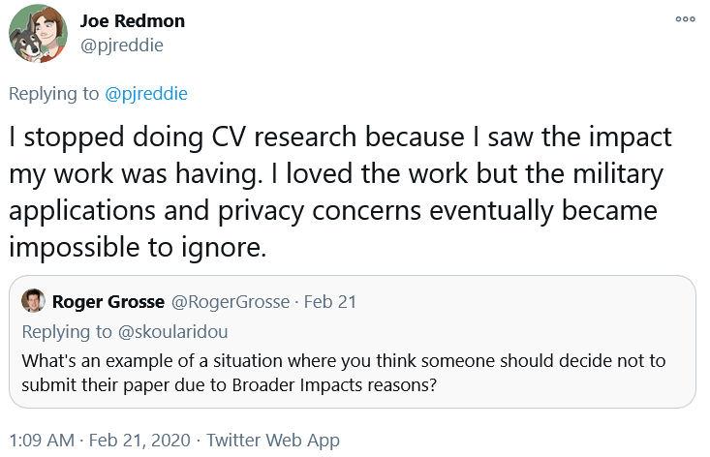
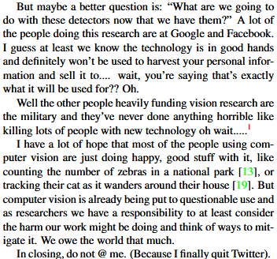
YOLOs’ Uniqueness: Curiosity vs Necessity
[Redmon et al, “Yolov3: An incremental improvement.”, arXiv 2018]
Computer Vision

Slide 48
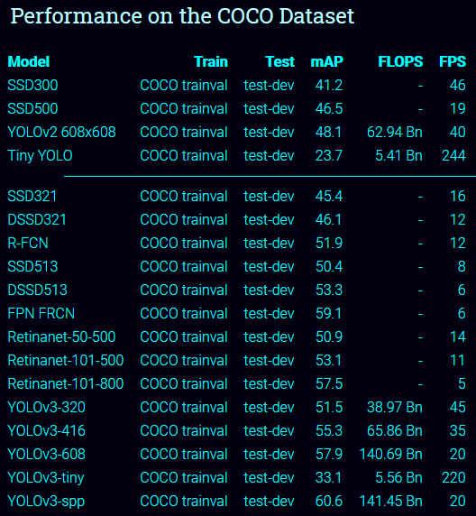

YOLO vs SSD
Computer Vision

Slide 49
Detection Without Anchors
Computer Vision

Slide 50

Current SoTA
Detection relies on the anchor boxes
Can we do detection without anchors?
Computer Vision

Slide 51

Detection without Anchors: CornerNet
Represent bounding boxes by pairs of corners
Use a pair of networks to predict position and embedding of top-left and bottom-right corner
Matching corners are trained to have similar embeddings
[Law and Deng, “CornerNet: Detecting Objects as Paired Keypoints”, ECCV 2018]
Computer Vision

Slide 52

Detection without Anchors: CornerNet
Upper left corners
Heatmap: C x H x W
Embeddings: D x H x W
Lower right corners
Heatmap: C x H x W
Embeddings: D x H x W
[Law and Deng, “CornerNet: Detecting Objects as Paired Keypoints”, ECCV 2018]
Computer Vision

Slide 53




Detection without Anchors: CornerNet
[Law and Deng, “CornerNet: Detecting Objects as Paired Keypoints”, ECCV 2018]
Computer Vision

Slide 54
Detection without Anchors: CornerNet
(+) No Anchors
(+) Outperform most of the one-stage methods
(–) performance is still restricted, especially for small objects
(–) has a weak ability referring to the global information of the object
(–) What the embeddings learned are still not clearly defined/studied
[Carion et al, “End-to-End Object Detection with Transformers”, ECCV 2020]
Computer Vision

Slide 55

Detection without Anchors: CenterNet
Follow-up to the CornerNet
[Kaiwen Duan et. al., “CenterNet: Keypoint Triplets for Object Detection”, ICCV 2019]
Computer Vision

Slide 56
Detection without Anchors: Transformers
DETR: End-to-End Object Detection with Transformers
Bounding boxes and image features are communicating with each other
Encoder-Decoder Self-Attention to perform feature mapping
Predict fixed N-pairs of (class and box)
[Carion et al, “End-to-End Object Detection with Transformers”, ECCV 2020]
Computer Vision

Slide 57
Detection without Anchors: Transformers
[Carion et al, “End-to-End Object Detection with Transformers”, ECCV 2020]
Computer Vision

Slide 58

Recall: Non-Max Suppression Problem
NMS may eliminate ”good” boxes when objects are highly overlapping…
no good solution
Computer Vision

Slide 59
Detection without Anchors: Transformers
[Carion et al, “End-to-End Object Detection with Transformers”, ECCV 2020]
Computer Vision

Slide 60
Detection without Anchors: Transformers
(+) No RPN!
(+) No anchors!
(+) No NMS!
(+) “Deep Learning”-ish
(–) Slow and brittle to train
(–) Worse than Faster R-CNN for small objects
[Carion et al, “End-to-End Object Detection with Transformers”, ECCV 2020]
Computer Vision

Slide 61


Detection without Anchors: Transformers
[Carion et al, “End-to-End Object Detection with Transformers”, ECCV 2020]
Computer Vision

Slide 62
Recap
Computer Vision

Slide 63
TL;DR
“Slow” R-CNN:
Run CNN independently for each region
Fast R-CNN:
Apply differentiable cropping to shared image features
Faster R-CNN:
Compute proposals
with CNN
Single-Stage:
Fully convolutional
detector
Computer Vision

Slide 64
TL;DR – Localization
Find a fixed number of objects (one or many)
L2 regression from CNN features to box coordinates
Much simpler than detection
Overfeat: Regression + efficient sliding window
Deeper networks do better
Computer Vision

Slide 65
TL;DR – Object Detection
Find a variable number of objects by classifying image regions
Before CNNs:
dense multiscale sliding window (HoG, DPM)
Avoid dense sliding window with region proposals
Directly regress the bounding box
Computer Vision

Slide 66
TL;DR – Object Detection
R-CNN:
Selective Search + CNN classification / regression
Probably don’t use this; too slow
Fast R-CNN:
Swap order of convolutions and region extraction
Introducing RoI Pooling
Computer Vision

Slide 67
TL;DR – Object Detection
Faster R-CNN:
Introducing Region Proposal Network
Compute region proposals within the network
Slower than YOLO but more accurate
Computer Vision

Slide 68
TL;DR – Object Detection
YOLO/SSD
Go from input image to tensor of scores with one big convolutional network
faster but not as accurate
Deeper networks do better
Computer Vision

Slide 69
TL;DR – Object Detection without Anchors
CornerNet
Detect two corners with embedding
CenterNet
CornerNet + center point
Object Detection with Transformer
Detect object with multi-attention
Computer Vision

Slide 70
Object Detection: Lots of variables
Backbone architecture used
Input resolution
Crop resolution
Number of anchors
Size of anchors
IoU threshold
Computer Vision

Slide 71

Object Detection Progress
Computer Vision

Slide 72

Object Detection Progress
Huang et al, “Speed/accuracy trade-offs for modern convolutional object detectors”, CVPR 2017
Computer Vision

Slide 73



Object Detection Progress
Takeaways:
Two stage method (Faster R-CNN) get the best accuracy, but are slower
Single-stage methods (SSD) are much faster, but don’t perform as well
Huang et al, “Speed/accuracy trade-offs for modern convolutional object detectors”, CVPR 2017
Computer Vision

Slide 74
Object Detection Progress
Takeaways:
Bigger backbones improve performance, but are slower
Diminishing returns for slower methods
Huang et al, “Speed/accuracy trade-offs for modern convolutional object detectors”, CVPR 2017
Computer Vision

Slide 75
Recent Advancement
GPUs have gotten faster, Train Longer
Improved performance with many tricks
Multiscale backbone: Feature Pyramid Networks
Better backbone: ResNeXt-101
Single-Stage methods have improved
Very big models work better
Test-time augmentation pushes numbers up
Big ensembles, more data, etc.
Computer Vision

Slide 76
Object Detection Progress
For MS COCO dataset, only YOLOv2 can get real-time performance among other approach (2018)
Single-Stage Detector becoming more competitive
Computer Vision

Slide 77
New Entries:
Faster R-CNN w/ResNet-101-FPN, longer training (63ms, 42.0 mAP)
Faster R-CNN w/ResNeXt-101-FPN, longer training (120ms, 43.0 mAP)
RetinaNet (SSD-like) w/ResNet-101 (80ms, 39.9 mAP)
Mask R-CNN w/RexNeXt-152 (281 ms, 49.3 mAP)
Mask R-CNN w/RexNeXt-152 +Test-time augmentation (? ms, 51.4 mAP)
Current leaderboard winner: 58-60 mAP https://competitions.codalab.org/competitions/20794#results
Computer Vision

Slide 78
Object Detection: Open-Source Code
TensorFlow Detection API:
https://github.com/tensorflow/models/tree/master/research/object_detection
Faster R-CNN, SSD, RFCN, Mask R-CNN
Detectron2 (PyTorch):
https://github.com/facebookresearch/detectron2
Fast / Faster / Mask R-CNN, RetinaNet
Computer Vision

Slide 79

Question?
Computer Vision

Slide 80

Next Agenda
More Detection
Segmentation
Computer Vision

Slide 81
References
Fei-Fei Li, Justin J, Serena Y - Stanford CS231n 2018 Course
Justin Johnson– EECS498 Lectures, University of Michigan
Yogesh Singh Rawat – CAP5415 Lectures, University of Central Florida
Grauman, K. and Leibe, B. 2011. Visual Object Recognition. Synthesis Lectures Artif. Intell. Mach. Learn. 5, 1 181
Computer Vision
Notes:
http://jefkine.com/general/2016/09/05/backpropagation-in-convolutional-neural-networks/
https://grzegorzgwardys.wordpress.com/2016/04/22/8/
http://andrew.gibiansky.com/blog/machine-learning/convolutional-neural-networks
http://www.slideshare.net/kuwajima/cnnbp
http://soumith.ch/ex/pages/2014/08/07/why-rotate-weights-convolution-gradient

